Slide 1

HEART DISEASE PREDICTION
Presented By:
Sai Chandana Pathipati
Madhumitha Donthineni
Manoj Krishna Varma Tirumani
Sai Kiran Rao Sagi
Venkateshwara Rao Narra

Slide 2

INTRODUCTION
Heart disease is one of the biggest reason for death across the globe. As it is a cause of 35% of total death across worldwide.
Artificial Intelligence can play an essential role in predicting Heart Diseases.

Slide 3
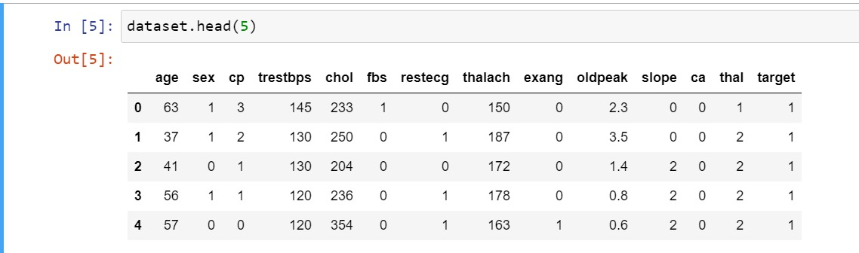
DATASET

Slide 4
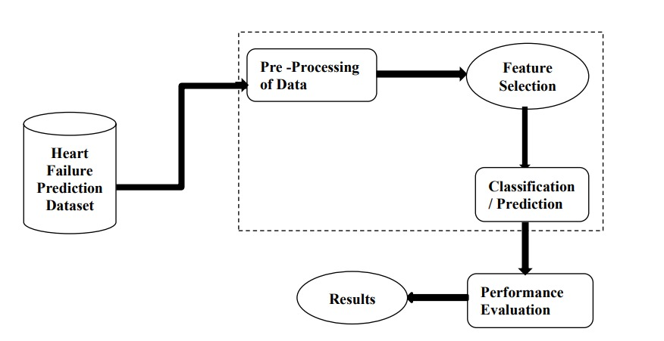
DATA PRE_PROCESSING

Slide 5
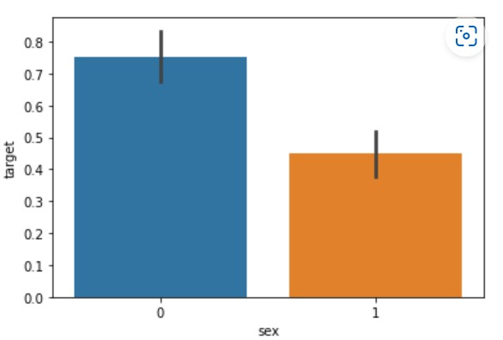
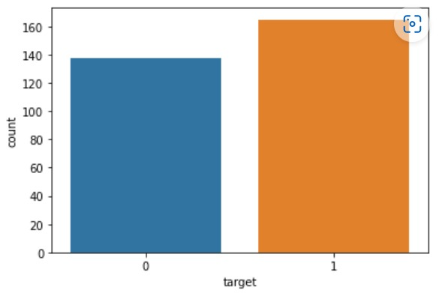
DATA ANALYSIS

Slide 6
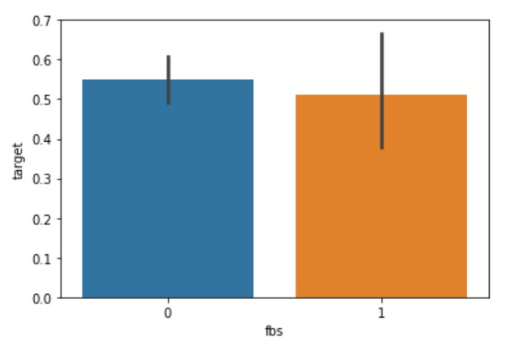
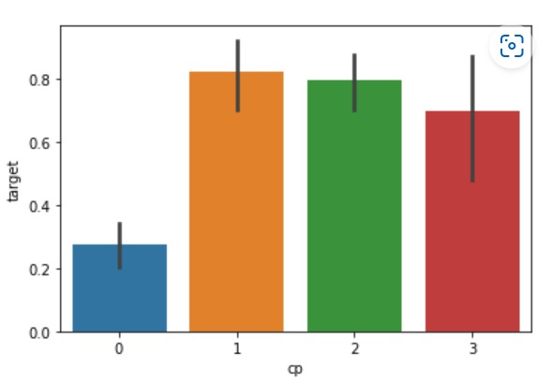

Slide 7
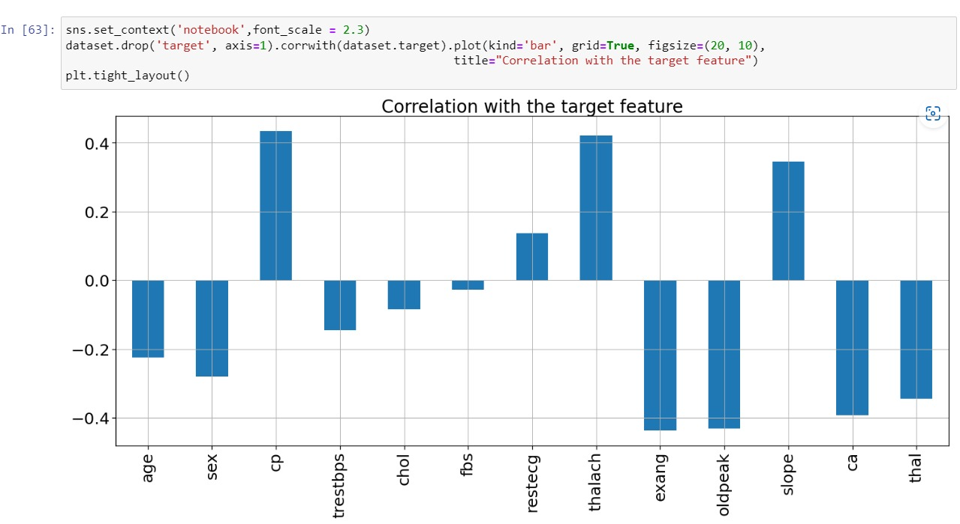

Slide 8

ALGORITHMS
Naïve Bayes
XG Boost
Support Vector Machine
Decision Tree
Random Forest

Slide 9
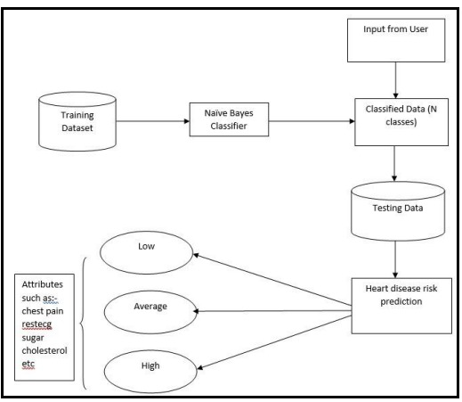
Naïve Bayes

Slide 10
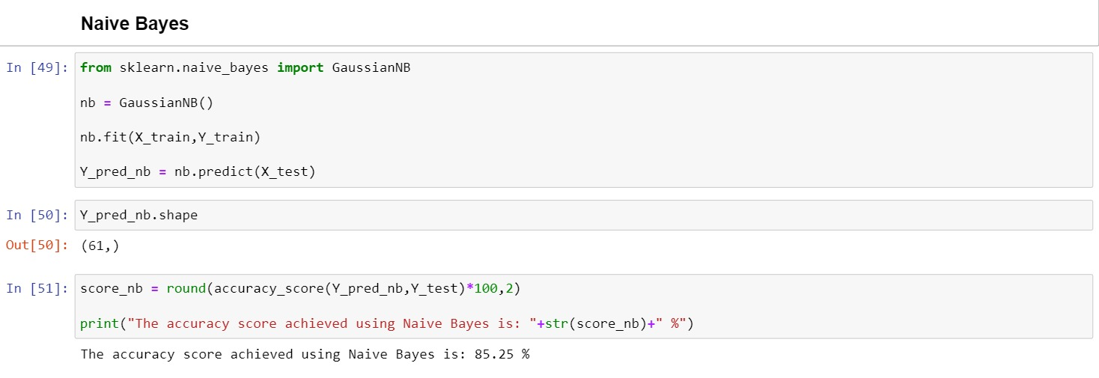

Slide 11
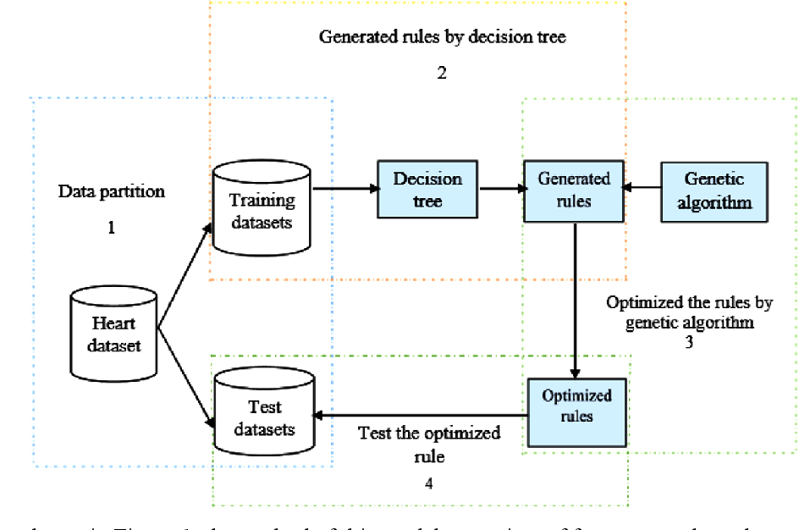
Decision Tree

Slide 12
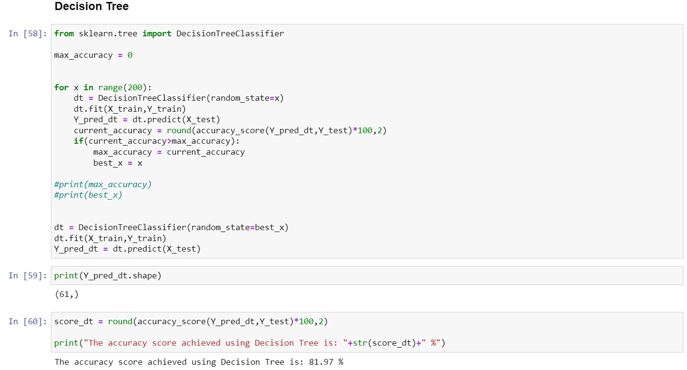

Slide 13

Support Vector Machine

Slide 14
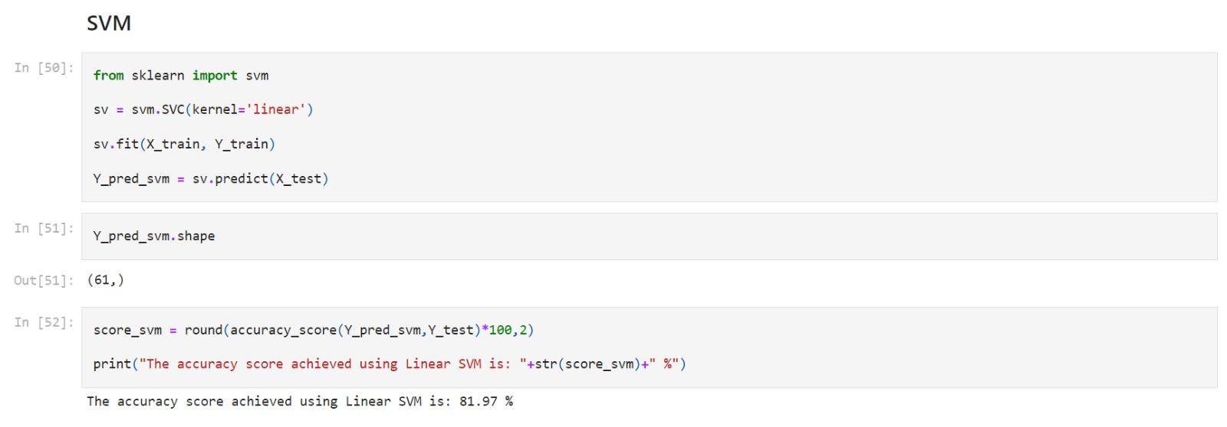

Slide 15
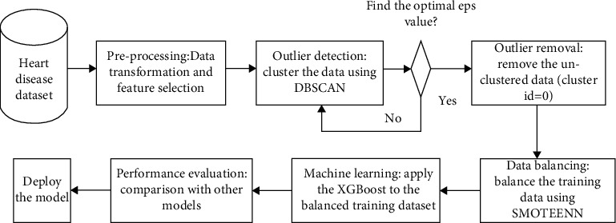
XG Boost

Slide 16
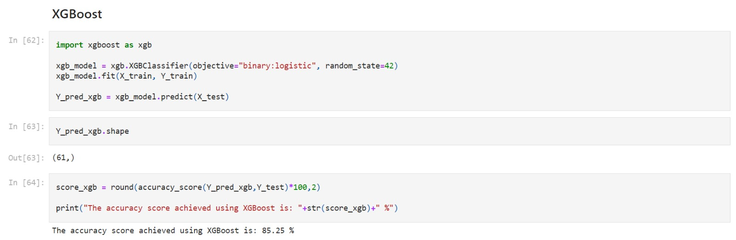

Slide 17

Random Forest

Slide 18
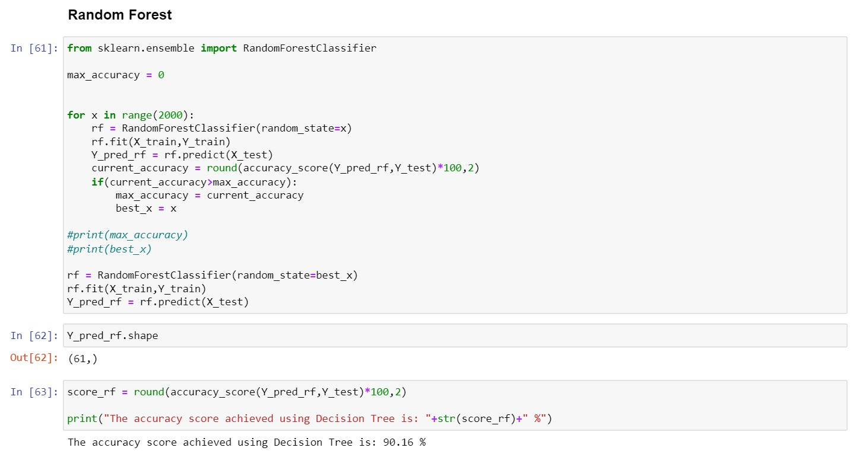

Slide 19
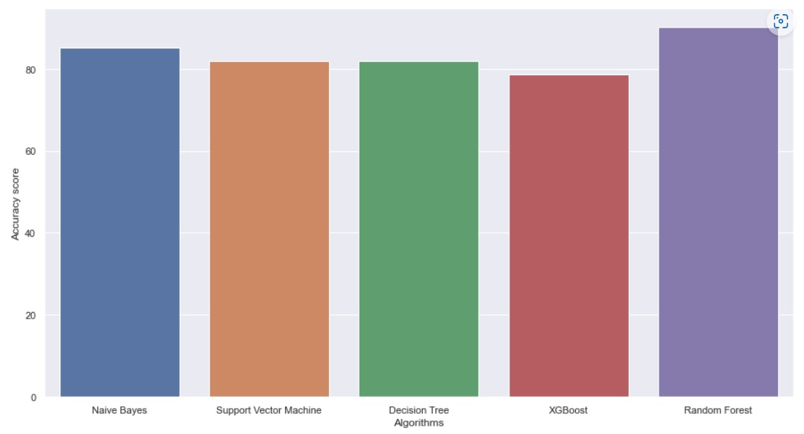
COMPARISION OF ALGORITHM

Slide 20


